Slide 1


Slide 2
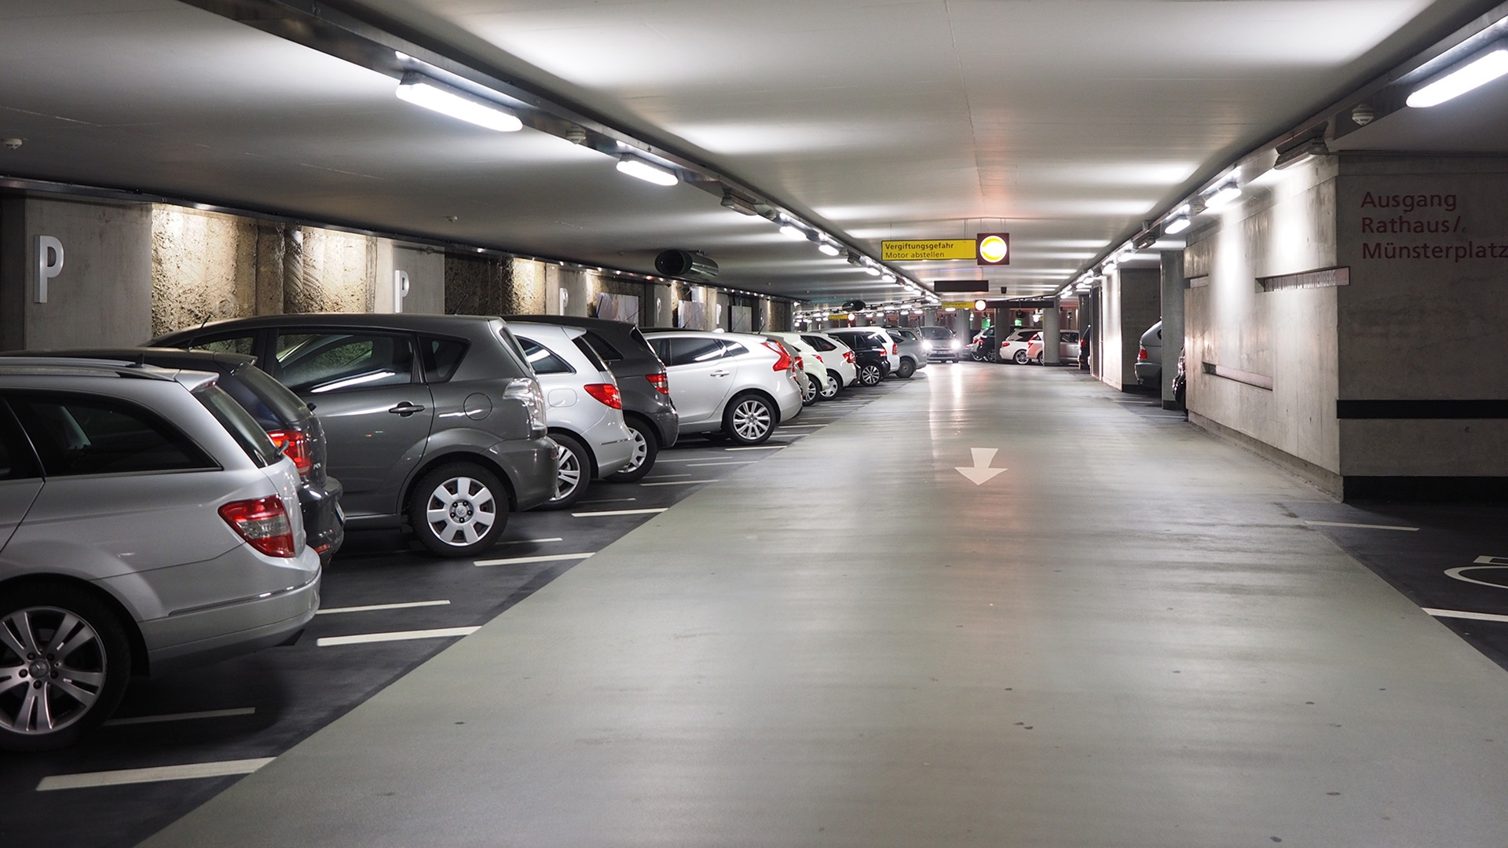

SMART CAR PARKING SYSTEM Digital Logic Design
BEE 11-B GROUP NUMBER 4

Slide 3
TEAM LEADER: Reg. No. Ch. Muhammad Shaheer Yasir 286021 TEAM MEMBERS: Farheen Gul 290352 Muhammad Hamza 290951 Amna Abid 321913

Slide 4
INTRODUCTION
One of the major techniques that forms the basis of all digitally integrated circuits is Digital Logic Design. Using these techniques, we have come forth with a system aimed at aiding drivers with parking.
Due to the rapid increase in the number of vehicles on the road, traffic problems are also on the rise. This is due to the fact that the current transportation infrastructure and car parking facilities developed are unable to cope with the influx of vehicles on the roads. One main problem is revealed to be the lack of a proper system to help vehicles park efficiently, given the exponential rise of huge parking areas and vehicles alike. we have developed a “Smart Parking System”.

Slide 5
INTRODUCTION
With the implementation of the Smart Parking System, patrons can easily locate and secure a vacant parking space at any empty car park spot that is deemed convenient by them.
The main aim of this project is to effectively and efficiently provide a system that; helps in reducing the traffic that occurs within parking lots, furthermore works to reduce the time lost while searching around a place that is already at maximum capacity. Vehicle detection plays a crucial role in this, as the smart parking system is implemented through a system that uses the help of various sensors and counters, which help in keeping a check where a spot in the parking lot is currently empty and guides the drivers to that spot with the help of LEDs

Slide 6
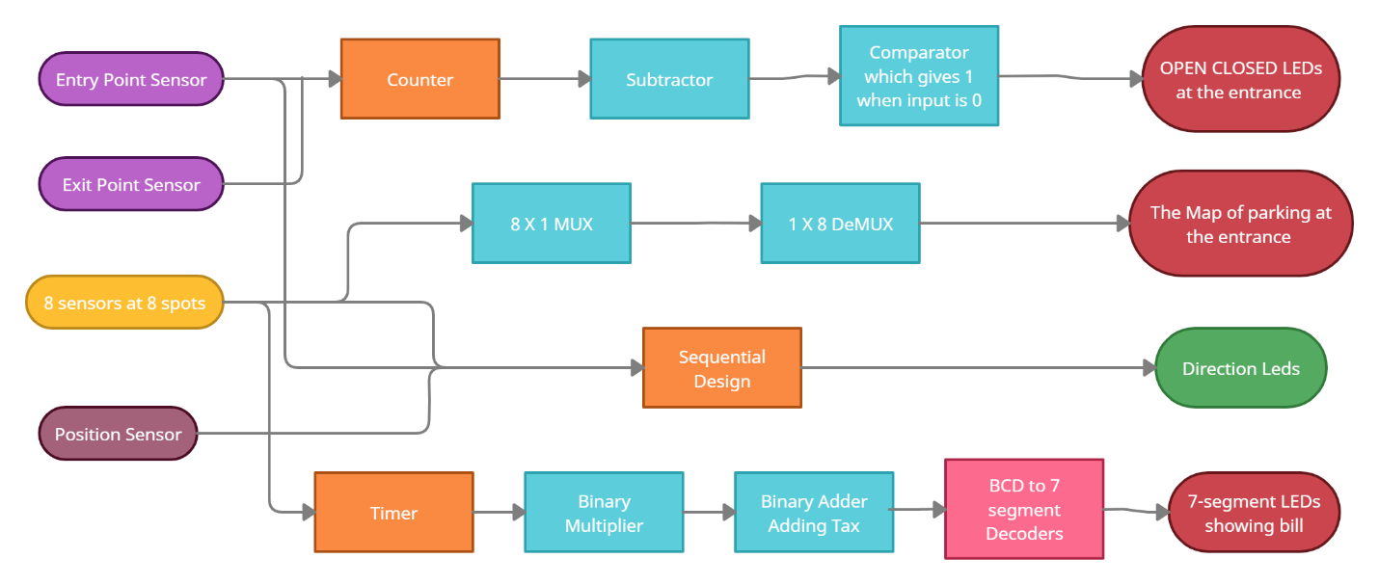
BLOCK DIAGRAM

Slide 7
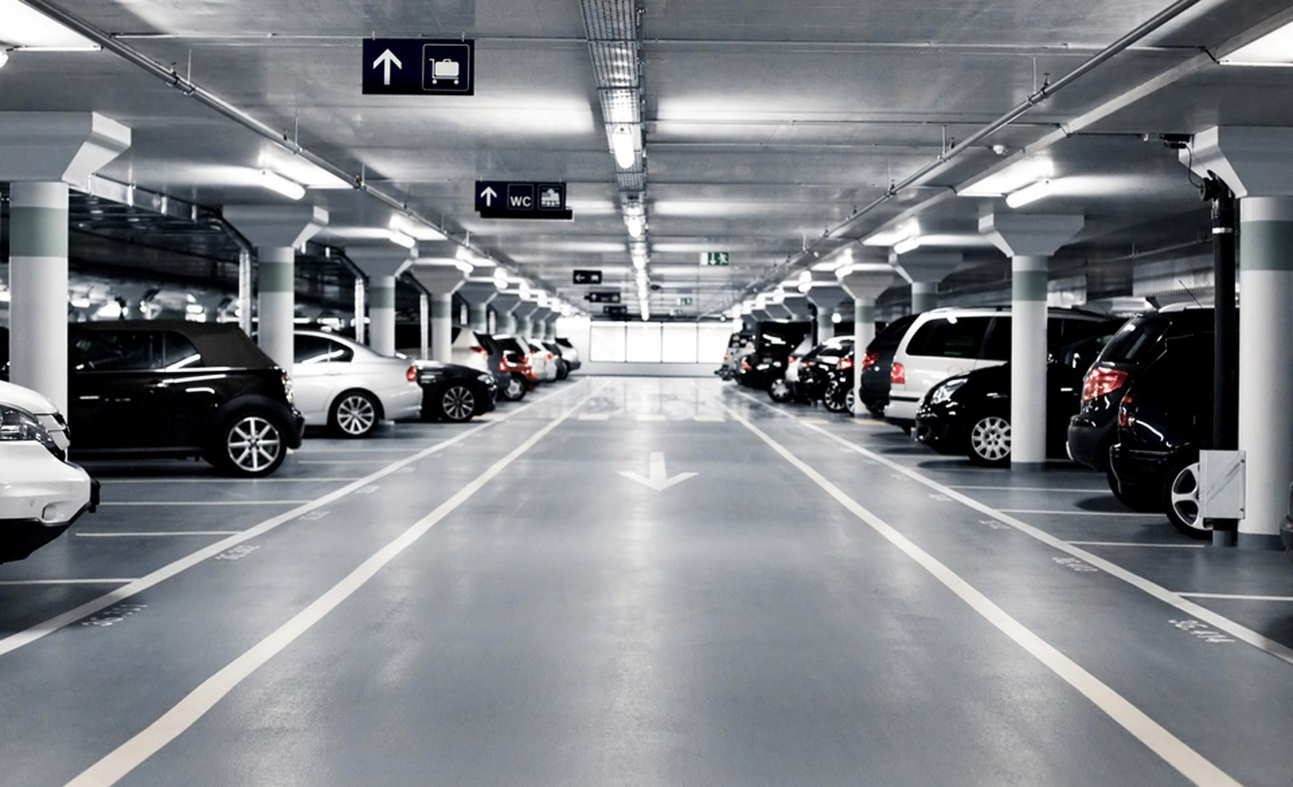

DIVISIONS OF WORK
ALLOCATED

Slide 8
Parking Space indicator & Smart Street Light System
This design consists of open/closed LED at the entrance which will give an information whether parking for new upcoming is available or not.
Two motion sensors along light sensor for smart street system are located at the entrance and the exit of the parking lot.
It will provides a real time counting of spots occupied & not-occupied at seven segment LED display.
Also, when there will be no space available, the gate of the parking system will not open until some car leaves the parking.
It will also conserve energy by turning on & off the street lights according to day /night time.

Slide 9
Parking Space indicator & Smart Street Light System
Smart street light turn on at night
When cars are present within
Light sensor

Slide 10
Car Parking Map:
This design of the car parking map at the entrance will gives the driver a visual depiction of which spots are available, and which are filled.
The system will take 8 inputs from 8 sensors preinstalled at 8 parking spots.
Now a multiplexer will be used convert their inputs to one output coming at the entrance.
That output is again de-multiplexed at the entrance giving 8 outputs which are then connected to LEDs in the parking map.
An on red LED shows presence of car while as an LED off mark as empty slot.

Slide 11
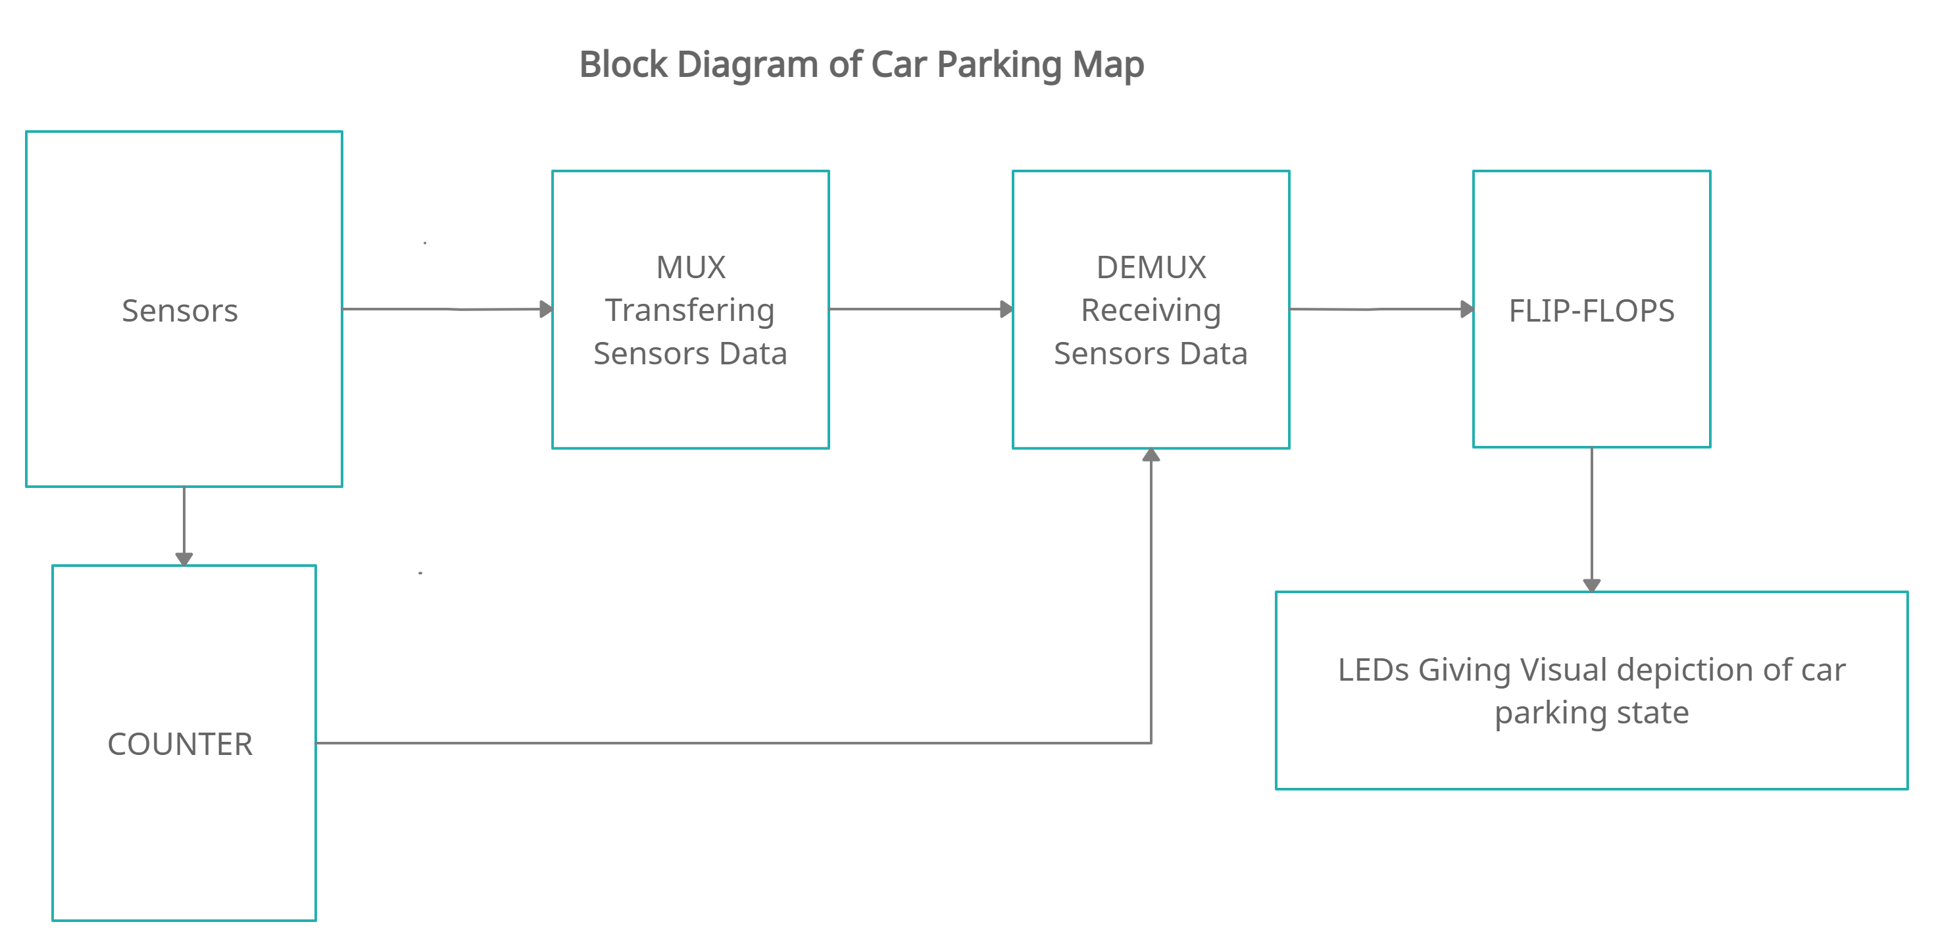
Car Parking Map:

Slide 12
Direction LEDs:
This design will give directions to parking spot with the help of LEDs.
These LEDs will take input from entry point sensor, sensors at parking spots and position sensors and once the driver will enter in the parking, these LEDs will tell him/her where to park.
Moreover if the driver don’t park on the spot specified to him ,the position sensors will give input to system
Now the system will turn off the previous LEDs and turn on new LEDs to tell driver which next spot is available in the parking.
Also, as soon as the car is parked, all direction LEDs will turn off.

Slide 13
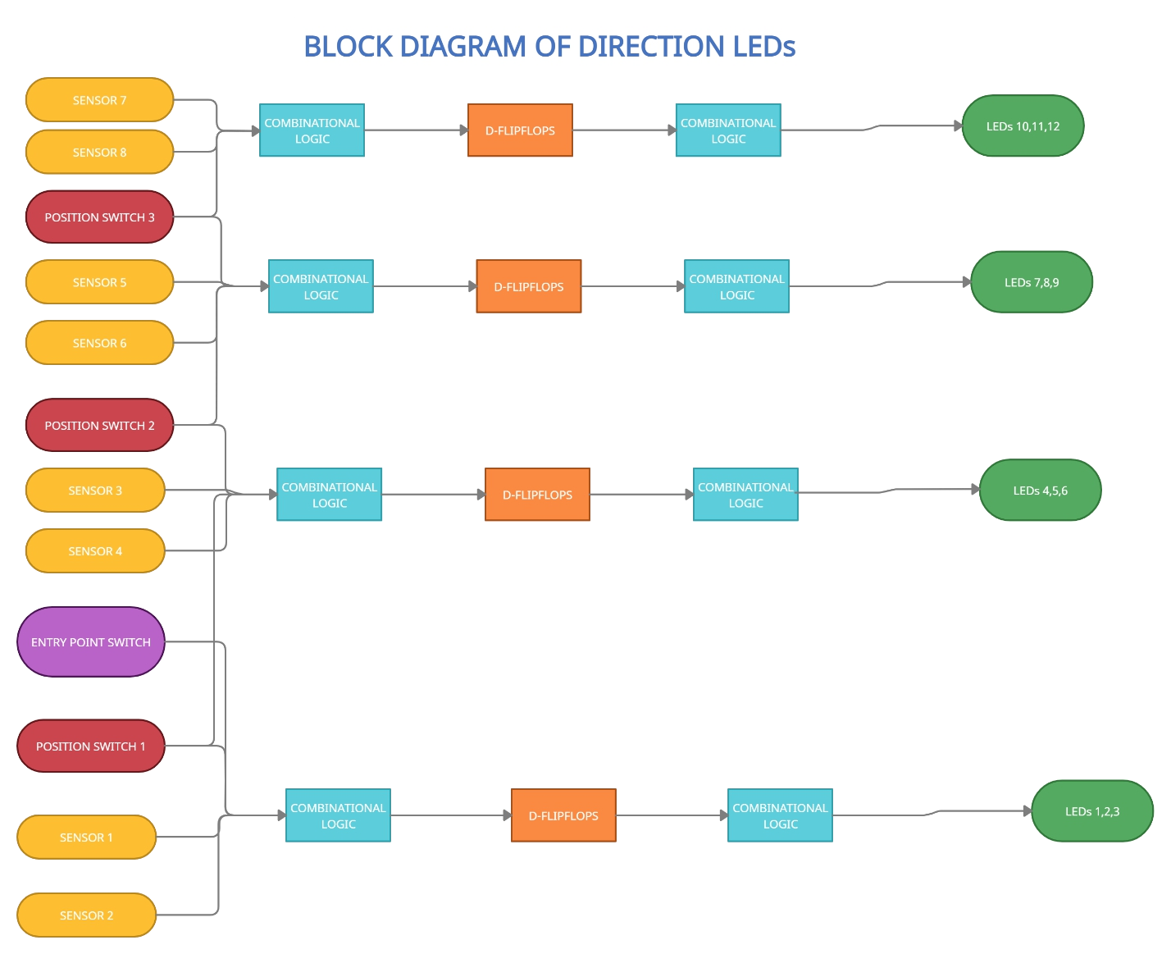
Direction LEDs:

Slide 14
Billing System:
This design also provide an option for billing .
As soon as the car is parked in the parking lot, the system will start a timer and the timer will be stopped when the car finishes its parking.
The timer will store the time of car parking and then send the output to binary multiplier which will multiply the time with rate specified per hour.
There will also be an input to timer which will reset it as soon the billing is done.
For 1 hour parking bill is fixed as 5 rupees, then a Tax of 2 Rupees is added in the bill.

Slide 15
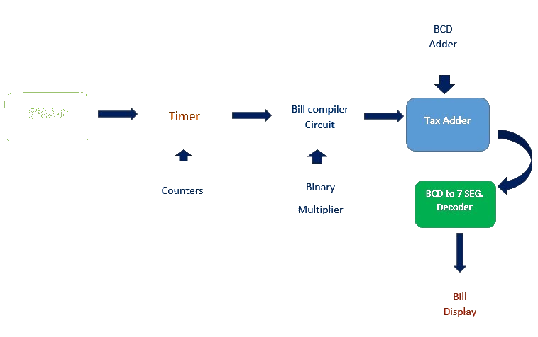
Billing System:
SENSORS

Slide 16
Conclusion:
The smart parking system is considered beneficial for the car park operators, car park patrons as well as for the conservation of the environment as it significantly reduces the amount of fuel burned going around in circles trying to find an empty spot.
As this system is completely digitally implemented, there is no more need for Parking workers.
The implementation of this project solves problems from an environmental perspective to the perspective of a business where the cheapest yet most efficient solutions are preferred to avoid the expenditure of unnecessary excess money.
This Smart Parking System is proposed to help combat the problems that arise in parking lots by providing a system that helps drivers to smoothly and quickly allocate an area to park without creating unnecessary traffic jams and wasting time going all around the parking lot.

Slide 17
